Slide 1
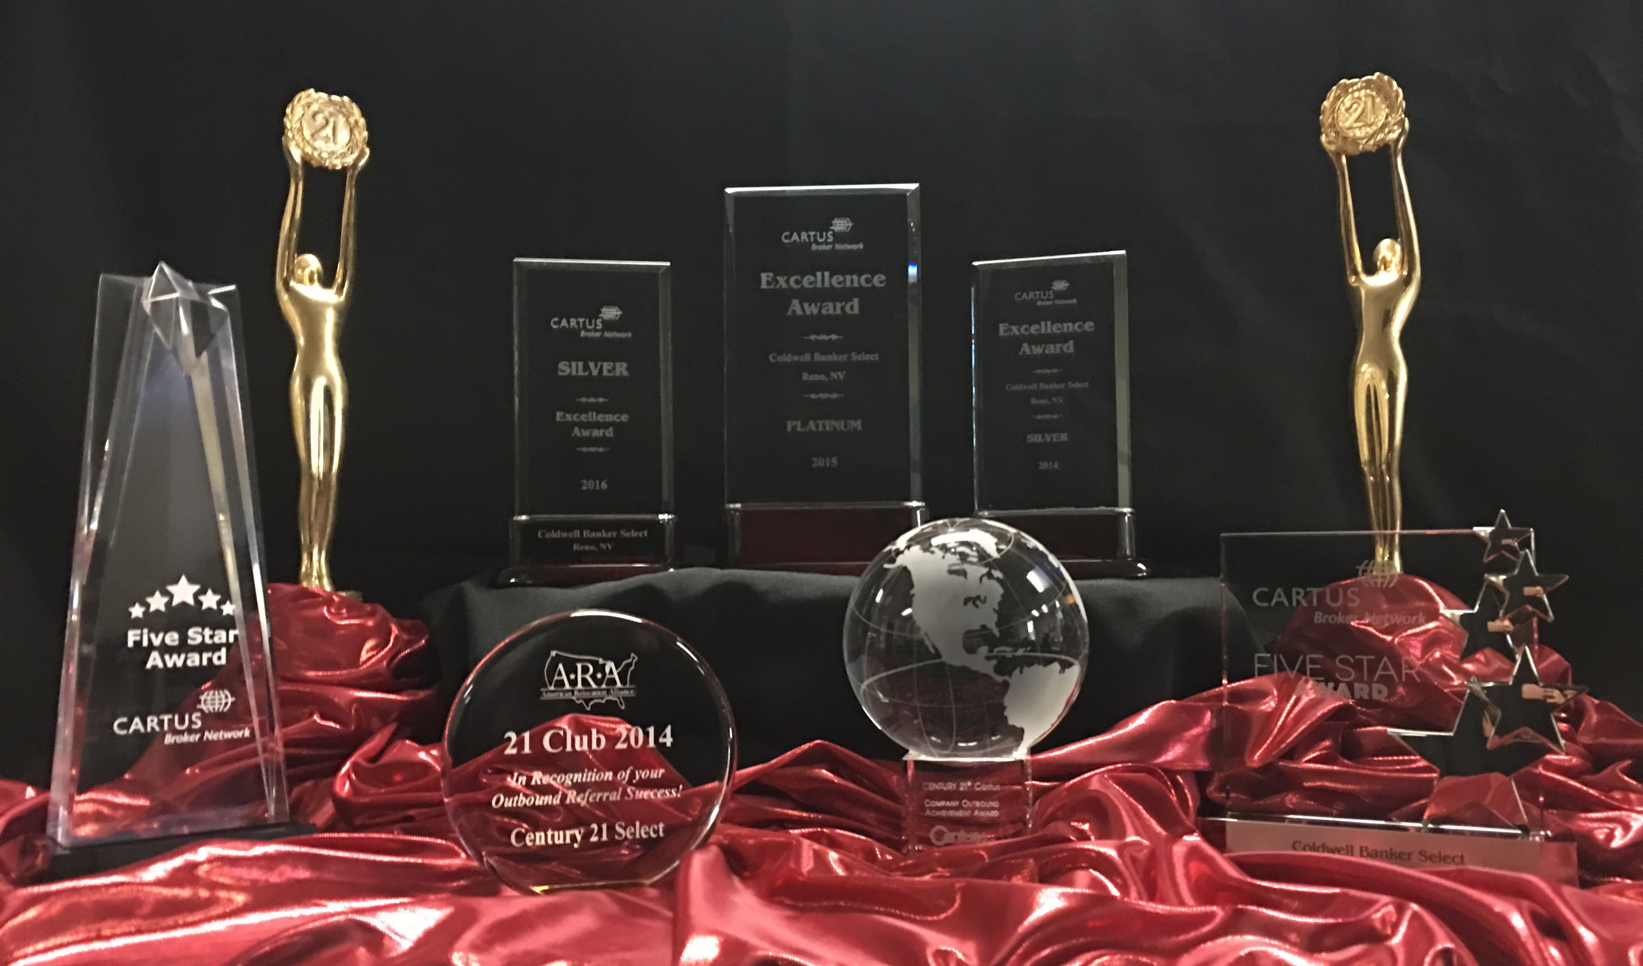

AGENT
GENERATED
REFERRALS

Slide 2
What is an Agent Generated Referral?
Q: What is the definition of an Agent Generated Referral?
A: An Agent Generated Referral is a lead generated in your local marketplace that does not have another real estate firm or benefits program attached to it as the referring source. The customer must be a member of any one of the Cartus Affinity organizations / associations, such as Navy Federal Credit Union, Realogy Military Rewards, AARP or American Airlines. There are others, but these are the ones we will focus on.
Q: How do you recognize a potential AGR?
A: Ask the simple questions when first meeting with a client. “Are you part of any organization that offers you a real estate benefit?” “Have you or any member of your family served in the military? Are you part of any military organization that offers a real estate benefit?” If they say yes, you have an AGR! Another key question is- Where you planning to secure financing? Or – you are doing a competitive listing presentation and upon touring the home, you notice military memorabilia. Consider mentioning your association with one of the military affinity programs and secure the listing!
Notes:
Facilitator:
REVIEW:
The definition of an Agent/company Generated Referral.
USE:
This time to discuss your company’s philosophy on AGRs/ Local Strategy and how an agent submits a lead.

Slide 3
AGR’s – Why Offer the Program?
It makes Good Business Sense
Looking for a way to build your business? Take advantage of your affiliation with Navy Federal Credit Union or Realogy Military Rewards for military families.
Over 50 client? They may be a member of AARP.
Does your client like to travel? They may have a membership with American Airlines to get airline miles.
You will have a Competitive edge – it is unique service that not many agents can provide!
Retention tool - Evokes loyal customers
Satisfied customers will tell their friends, family and co-workers
Notes:
Facilitator:
Agent Generated Referrals are the Network’s way of showing the value of our partnership to our corporate affinity clients, with the hope that ultimately it will increase your market share though member referrals and subsequent recommendations. The local market holds great opportunity and has been identified as a key driver to raise member awareness and increase capture rate.
Use this time to discuss your firm and agents benefits of being able to use their Cartus and Navy affiliation to grow their personal business.
As you heard in the video, placing Agent Generated business creates not only customer loyalty but generates spin off business that they would have probably not had.
Discuss your individual companies benefit structure to drive AGRs (i.e., favorable commission splits).
There are 4 easy questions that an agent can ask…
Are you part of any organization that offers you a real estate benefit?
Have you or any member of your family served in the military?
Are you part of any military organization that has relocation benefits?
Who are you planning to secure your financing with?

Slide 4
Agent Generated Referrals
Q: How do you submit an AGR?
A: First, instruct the customer NOT to call the program such as Navy directly to register. Explain to them that someone from the program will be contacting them.
In order to submit an AGR, you will need all customer contact information
Affinity Program
Customer Name
Address
Email, phone
Use the link in SBDG team member signature to complete the AGR (or outbound referral!)
SBDG will submit your customer to Cartus for enrollment into the Affinity Program.
Notes:
Facilitator:
CLARIFY:
Agent Generated Registration Process
Always ask your customers for permission to register them into the program.
Do not have your customers call the Affinity program directly. Always provide the customer's contact information to your relocation department who will register the lead on your behalf.

Slide 5
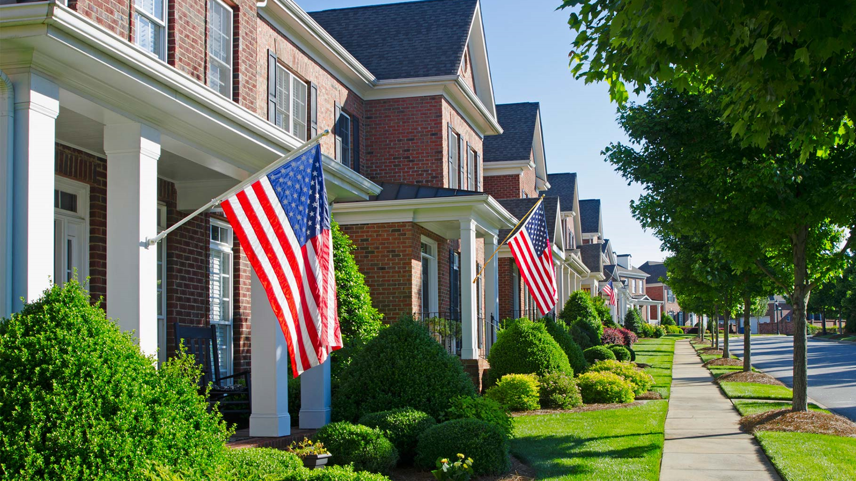
Why Promote the Affinity Real Estate Programs
Benefits to the Agent:
Set yourself apart from the competition
Create Loyalty that Lasts
Future Business
Repeat business: After 18 months we can enter a past client as an AGR
Higher commission payout for the agent vs. if the client enrolled themselves in the program & lower referral fee due to Cartus
Benefits to the Client
Either cash back or airline miles
Benefits that the member might not even realize they would qualify for if you didn’t tell them!
Notes:
Why Promote the Military Real Estate Programs
Agent:
By being part of the Realogy Network you have the advantage that other Brokerages in your area do not have. You have the ability to help those who served and their families obtain home finding/selling benefits other companies cannot.
Introducing these benefits to veterans will create loyalty as you will be seen as truly looking out for their best interest. In turn they will refer friends/family to you.
If a customer finds out about this benefit from another source your referral fee is higher and your commission split will be less
Client:
They have the opportunity to work with qualified agents that have been trained in working for military families.

Slide 6
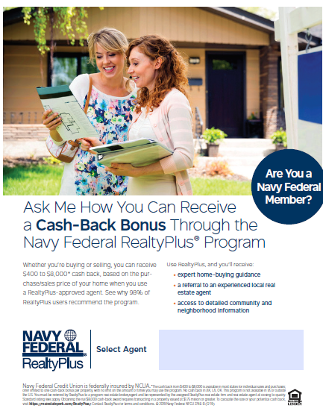
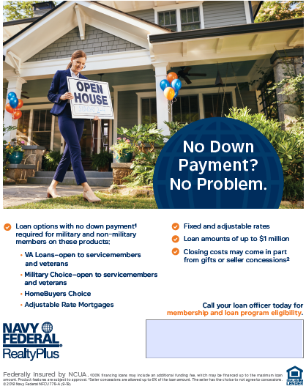

Slide 7

You can use this in your email signature

Slide 8
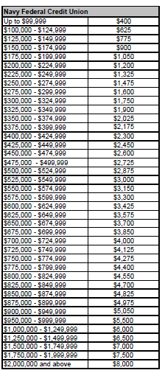
How much does the member receive?

Slide 9
How Much do you Pay?
Important things to remember, for the member to get their incentive you must pay a referral fee after closing.
You pay 30% of the commission earned at your regular split.
Here is an example
Cartus Agent Generated Referral (AGR) (NOT previously referred as a Website Lead) 30% Referral Fee
$300,000 Transaction
3% commission = $9,000
30 % referral fee deducted off the top = $2,700 (A portion of this goes to Realogy Military Rewards/NFCU/Affinity member as a cash incentive)
$9,000 commission less $2,700 = $6,300
$6,300 x 6% Franchise Fee = $378.00
Regular Split (example 70%) = $ 4,410
$4,410 - $378 = $4032.00
Additional Fees outside of SBDG:
Deduct E & O Insurance, TC Fee is Split 50/50 (Agent pays 50%, Select pays 50%) on Corporate Relocation and Affinity referrals. If a listing, $50 is deducted for Realtor.com listing enhancement

Slide 10
AGENT
GENERATED
REFERRALS 2020
Part 2

Slide 11

https://realestateperk.com/RealogyMilitaryRewards/

Slide 12

Why Promote the Military Real Estate Programs
Large Client Base
Military families move every 2-3 years on average
Family members are also eligible for the benefits which can lead to additional transactions from 1 client.
NAR Statistics
Of All Buyers: 2% are Active Military, 17% are Veterans and 81% are non-Military
Half of active-service military buyers are first time home buyers and 68% are first time sellers
19% of Veterans are First Time Home Buyers and 26% are First Time Home Sellers
Improving Metrics
AGRs help improve conversion. Clients we enter in the program convert at higher rates
Reinforces our partner relationship with the Affinity Program Affiliates
Client’s who we enter into the program tend to respond more frequently and positively to Service Evaluations
Notes:
Why Promote the Military Real Estate Programs
With military families typically moving every 2-3 years this means more opportunity for you to list/sell properties for them. Additionally with the program being for their families also they may have several family members they refer to you.
(I think statistics speak for themselves)

Slide 13
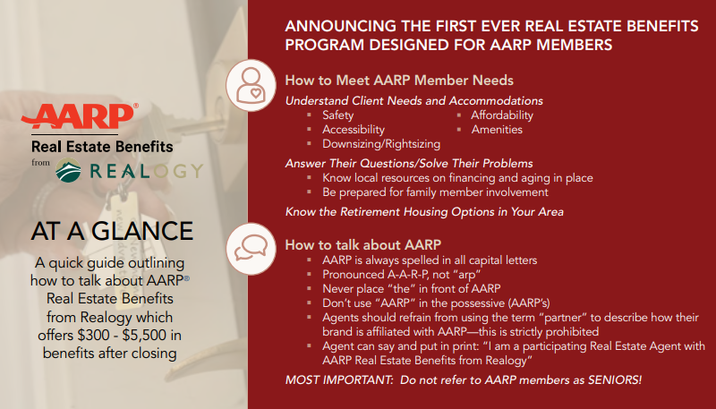
Alert! The Broker/Agent marketing materials are not yet available. As soon as they are ready, everything will be posted here and a nationwide announcement will be sent out. Thank you for your patience!

Slide 14

Ask everyone . . .
I have really enjoyed meeting both of you! By the way, did you know you may be eligible for rewards or special benefits when you buy or sell through me? If you have a minute, I’d like to tell you about how it works.
Builds loyalty and trust
Notes:
AGRs are a great way to grow your business.
Remember to ask everyone you speak with. It’s a great way to continue a conversation and also get a potential client connected to you. It builds loyalty and trust.
For our military, it makes them feel appreciated! Remember they move every 2 to 3 years and they may not know ANYONE in their new destination. Extending a little time to discuss options can make a huge impact on them and gain you a loyal new client.
Don’t forget clients who are Agent Generated into a program have a higher percentage of closing and returning excellent surveys! Plus they remember you to their family and friends which means more business for you!

Slide 15

Make it part of your Buyer or Seller Presentations:
I really appreciate your time and hope I have answered all your questions regarding your real estate transaction. Let me just add one more thing: I love giving back to our military for the sacrifices they make on my behalf. I’d like to enroll you in a program where you will receive a reward or cash bonus just for closing your transaction with me. This is a program that can really benefit you and there is no cost to you. Does that sound like something you would be interested in?
Notes:
Add a slide to your current Buyer and Seller presentations to remind you to have the discussion about affinity programs.
This makes you look super successful when you tell them how many programs you are associated with. This discussion can also set you apart from your competition in many instances.
Don’t forget to look for these military signs :
A Buyer who indicates they are getting a VA Loan
Military pictures or uniforms in the house
Veterans stickers or license plate on their car

Slide 16




Talk about the program at your Open House opportunities and/or provide flyers for all who enter.
Welcome!
Please come in and let me show you this great home!
Are you aware of the many affinity programs that might be available for you to take advantage of? I’d like to tell you about a few and how they can benefit you.
Notes:
It’s highly likely that up to this point anyone who visits your Open House has not heard of any of the Affinity programs.
You get to be the educator and informant and it also gives you a way to connect to them.
Don’t forget to get a flyer in their hands before they depart so they can refer back to you and the options you offer.

Slide 17
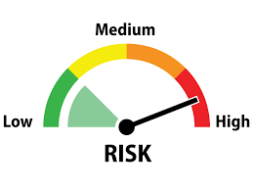
AGR’s – Why Offer the Program?
Is it Risky? Yes, if you don’t first offer the program, there is a risk!
If the member calls to enroll themselves in the program, the member could be referred to another agent OR another company.
Our company is one of at least 2 local
Real Estate companies that offers this
program to members.
Notes:
Facilitator:
Agent Generated Referrals are the Network’s way of showing the value of our partnership to our corporate affinity clients, with the hope that ultimately it will increase your market share though member referrals and subsequent recommendations. The local market holds great opportunity and has been identified as a key driver to raise member awareness and increase capture rate.
Use this time to discuss your firm and agents benefits of being able to use their Cartus and Navy affiliation to grow their personal business.
As you heard in the video, placing Agent Generated business creates not only customer loyalty but generates spin off business that they would have probably not had.
Discuss your individual companies benefit structure to drive AGRs (i.e., favorable commission splits).
There are 4 easy questions that an agent can ask…
Are you part of any organization that offers you a real estate benefit?
Have you or any member of your family served in the military?
Are you part of any military organization that has relocation benefits?
Who are you planning to secure your financing with?

Slide 18
Enrollment Process
Permission - Obtain permission from the customer prior to enrolling them into a Cartus Affinity program
Enrollment Information - Provide your Relocation Department the following information to initiate the enrollment process
Program Name – Name of the program the customer should be enrolled in
Enrollment Type – Buy, Listing or Both
Customer Name
Address
Phone Number
Email Address
Relocation Department – Will submit the enrollment information on your behalf
Advise - Advise the customer to NOT enroll themselves into the program. A dedicated program advocate will reach out to complete the enrollment process and explain the program eligibility and benefits
Notes:
Please gather all the information needed for enrollment from the customer prior to submitting an Agent Generated Referral.
If the customer is a NFCU member, you will need to obtain their NFCU member number prior to enrollment. For Realogy Military Rewards customers, please ask which family member served in the military and provide details to your Relocation Department.
Upon the successful AGR enrollment, a program advocate will reach out to the customer to review all the program details.
I would like to now play an agent testimonial – Thank you to our agent with Coldwell Banker SSK Realtors – Agent Hicks really summarizes why promote our military programs! Please take a listen!
PLAY VIDEO!

Slide 19

End Result?
Satisfied Customers with unlimited referral potential to build your
Business bigger than ever before!
Notes:
This concludes The 2020 Affinity Specialist Training.

